Slide 1
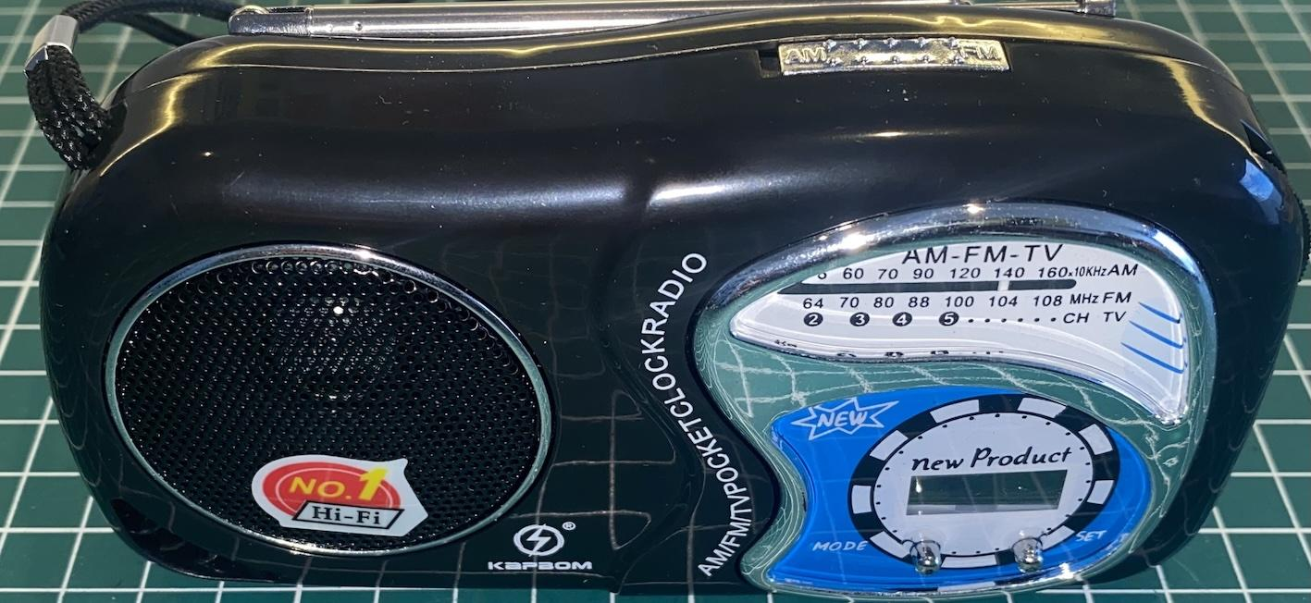
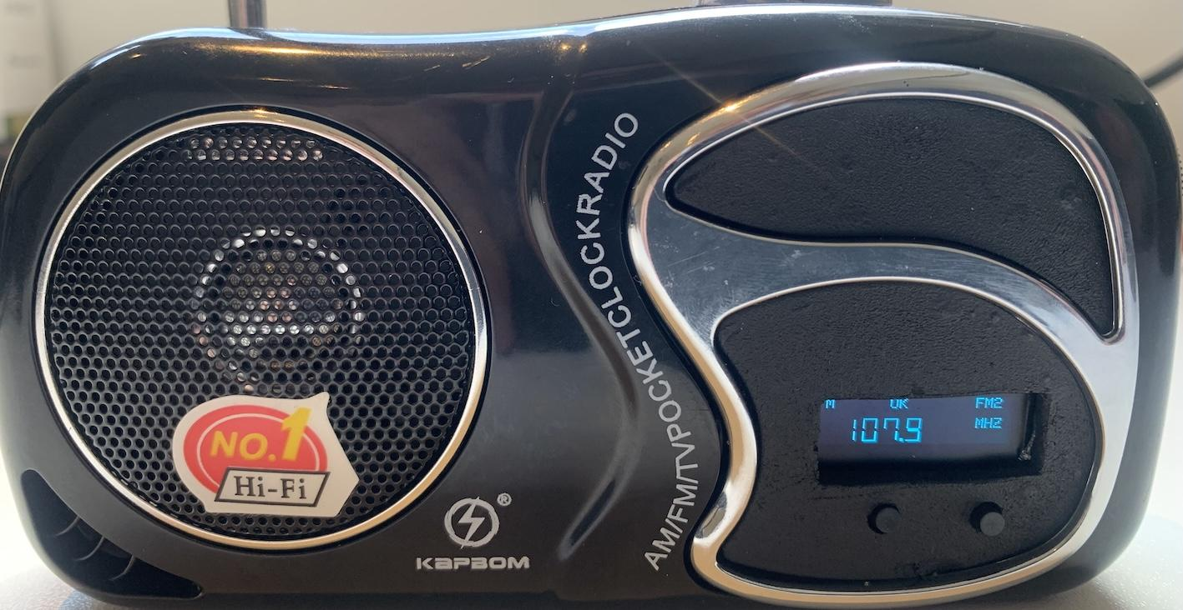
Converting a low-cost radio based on the Si4825 into a digital interface radio using the Si4827.

Slide 2
About the low-cost radio (KapBom K2019)
Two bands (MW and FM)
Less than $5
Compact and lightweight
Based on the Si4825 DSP
Sturdy plastic casing
Analog interface
Warning: There are other receivers from different manufacturers that use the same casing but are not
equipped with the Si4825. Be sure the receiver is equipped with the Si4825.

Slide 3
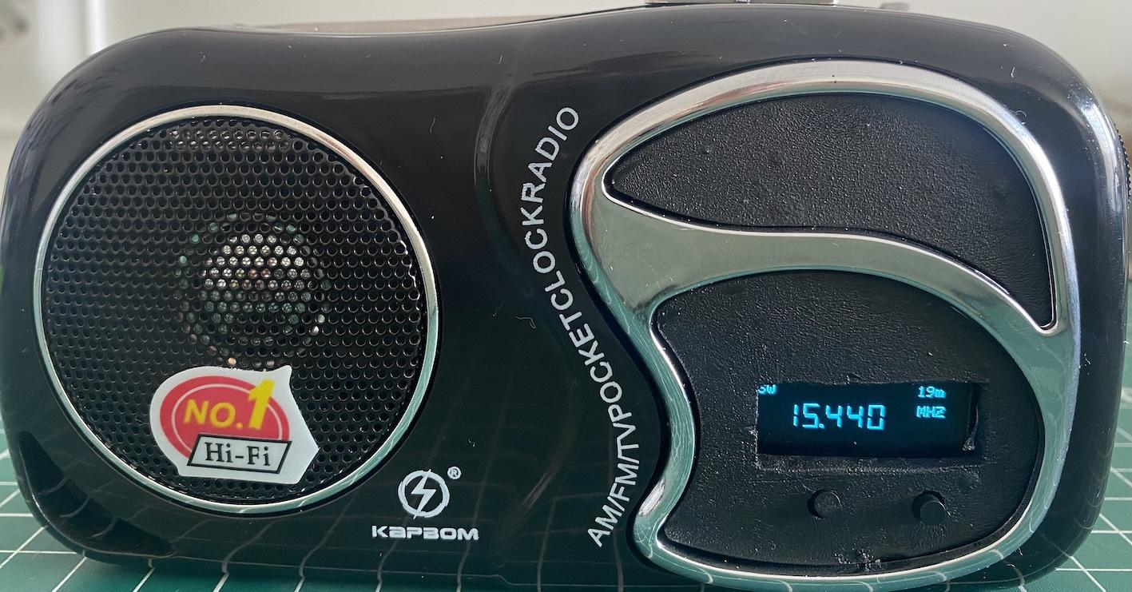
About the modified radio
15 bands (3 FM, 2 AM, and 10 SW)
Bands can be configured via programming
Based on the Si4827 DSP
Uses the Seeeduino XIAO controller (ARM Cortex-M0+)

Slide 4
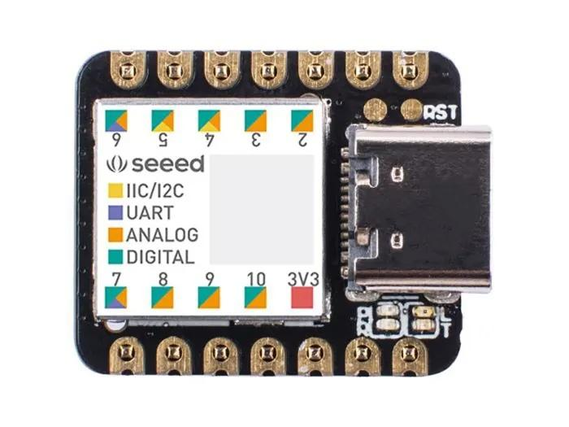
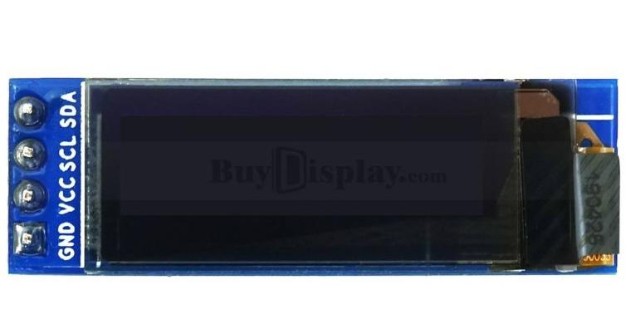
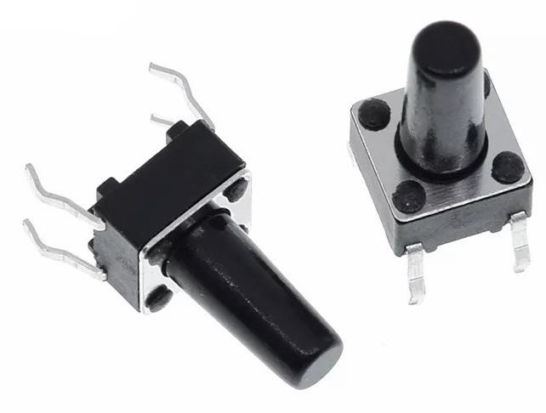
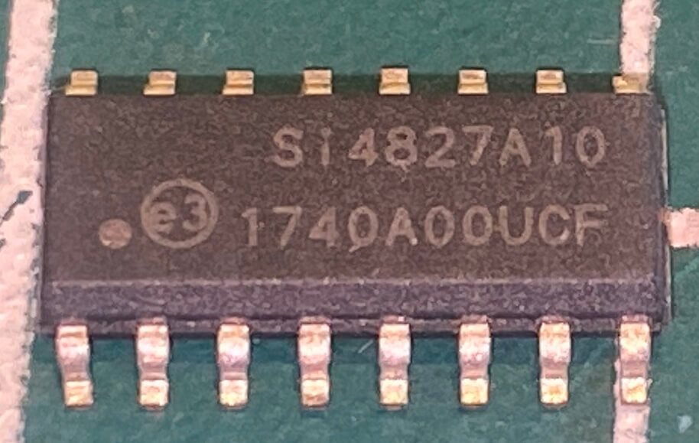
Components used for the modification
OLED I2C
Push Buttons
SEEEDUINO XIAO
ARM Cortex-M0+
SI 4827

Slide 5
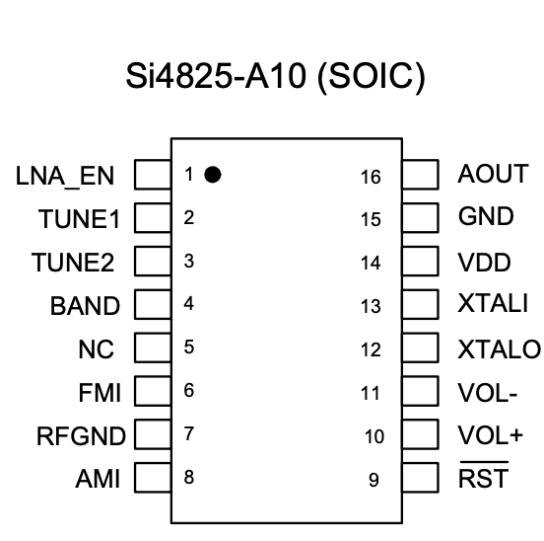
About the DSP Si4825
Support for FM band (64–109 MHz)
Support for AM band (504–1750 kHz)
Support for SW band (2.3–28.5 MHz)
No manual calibration required
Mono audio output
Band configuration according to region (AM/FM/SW)
Enhanced coverage for FM/SW bands

Slide 6
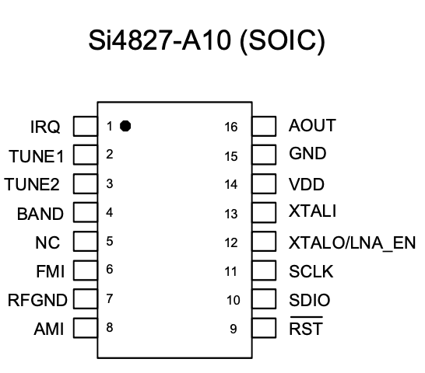
About the DSP Si4827
Support for FM band (64–109 MHz)
Support for AM band (504–1750 kHz)
Support for SW band (2.3–28.5 MHz)
Selectable support for all regional AM/FM/SW bands
Enhanced coverage of FM/SW bands
2-wire control interface (I2C)
Valid station indicator
Support for digital volume control
Support for bass and treble adjustment

Slide 7
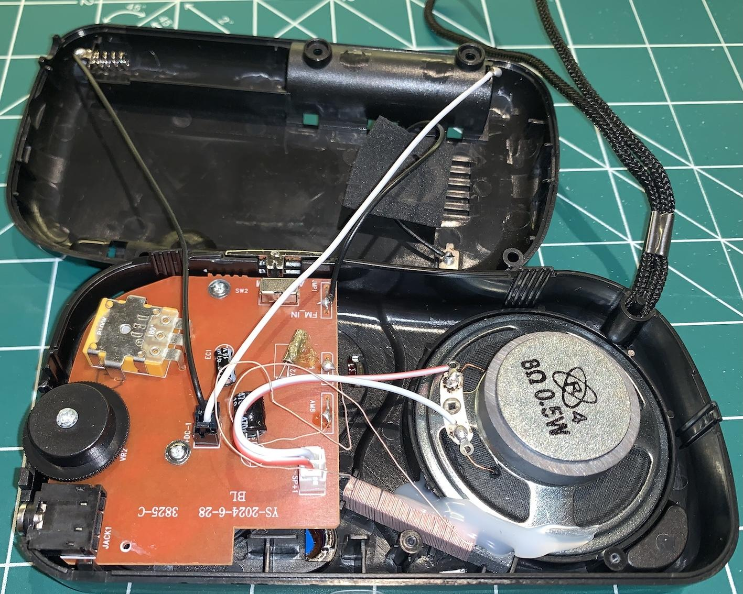
Open radio (before modification)

Slide 8
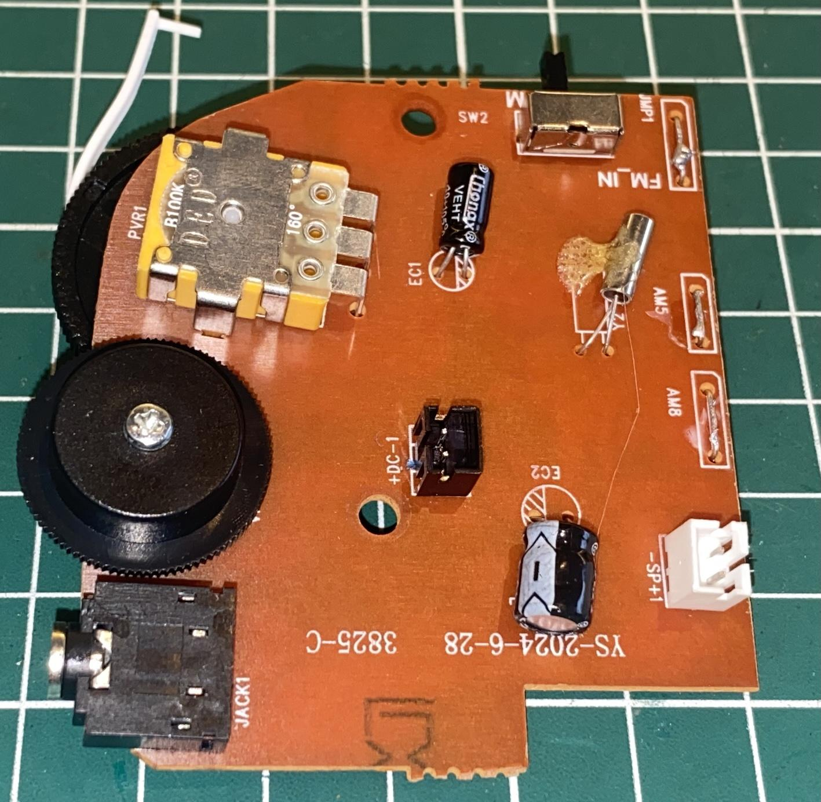
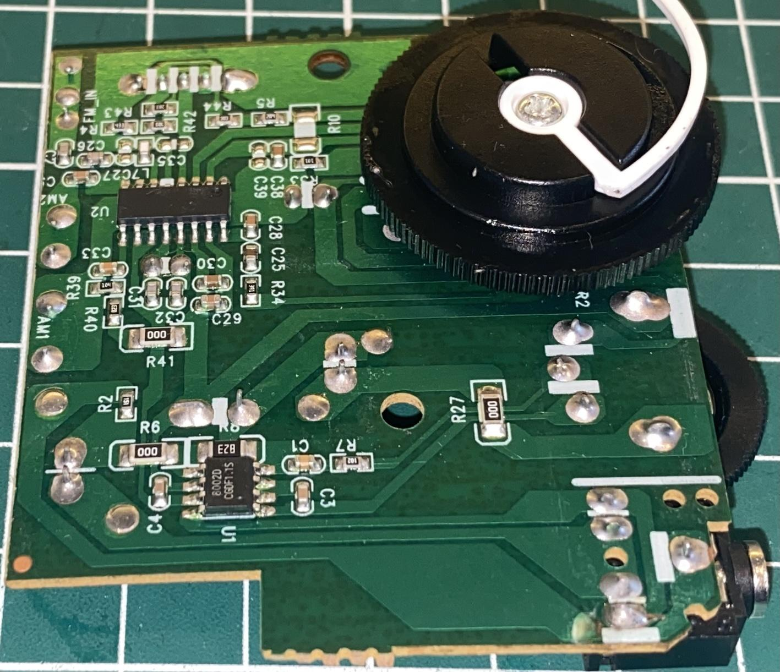
Board (before modification)

Slide 9
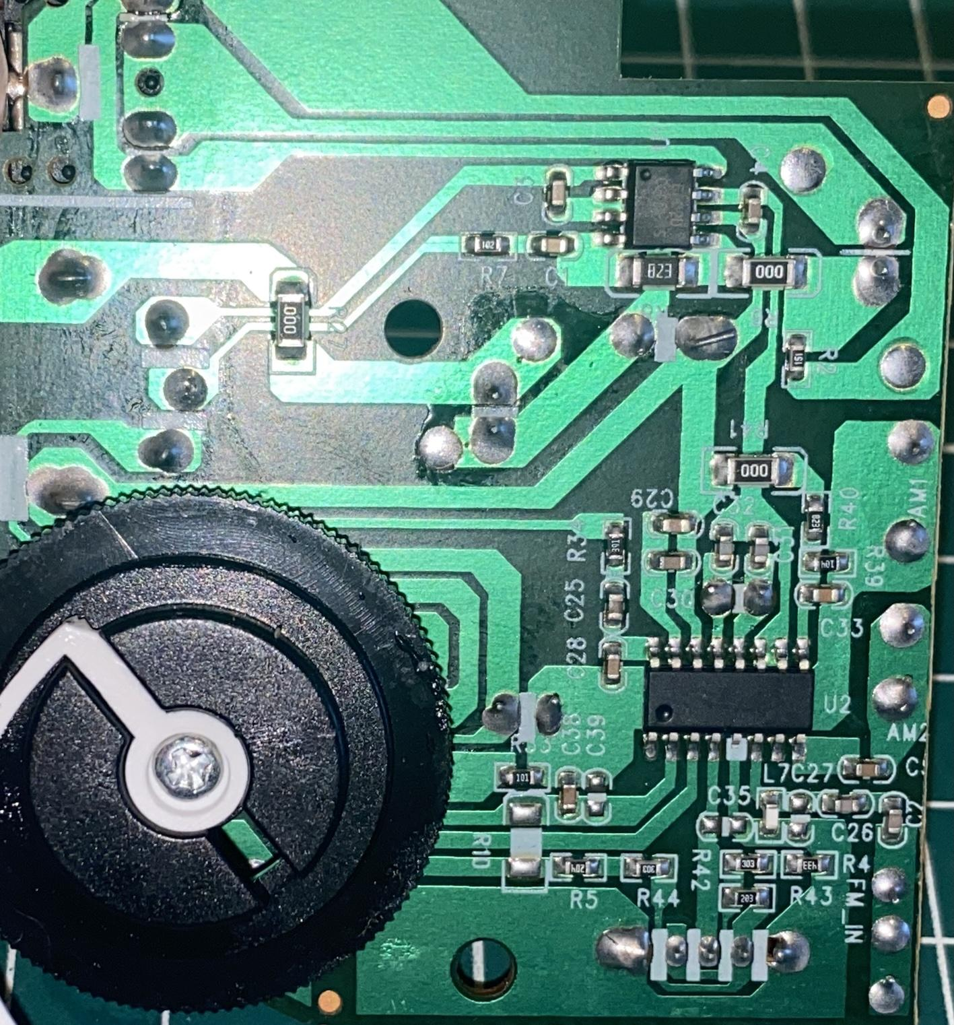
Si4825 Identification (Check if the radio is based on Si4825)

Slide 10
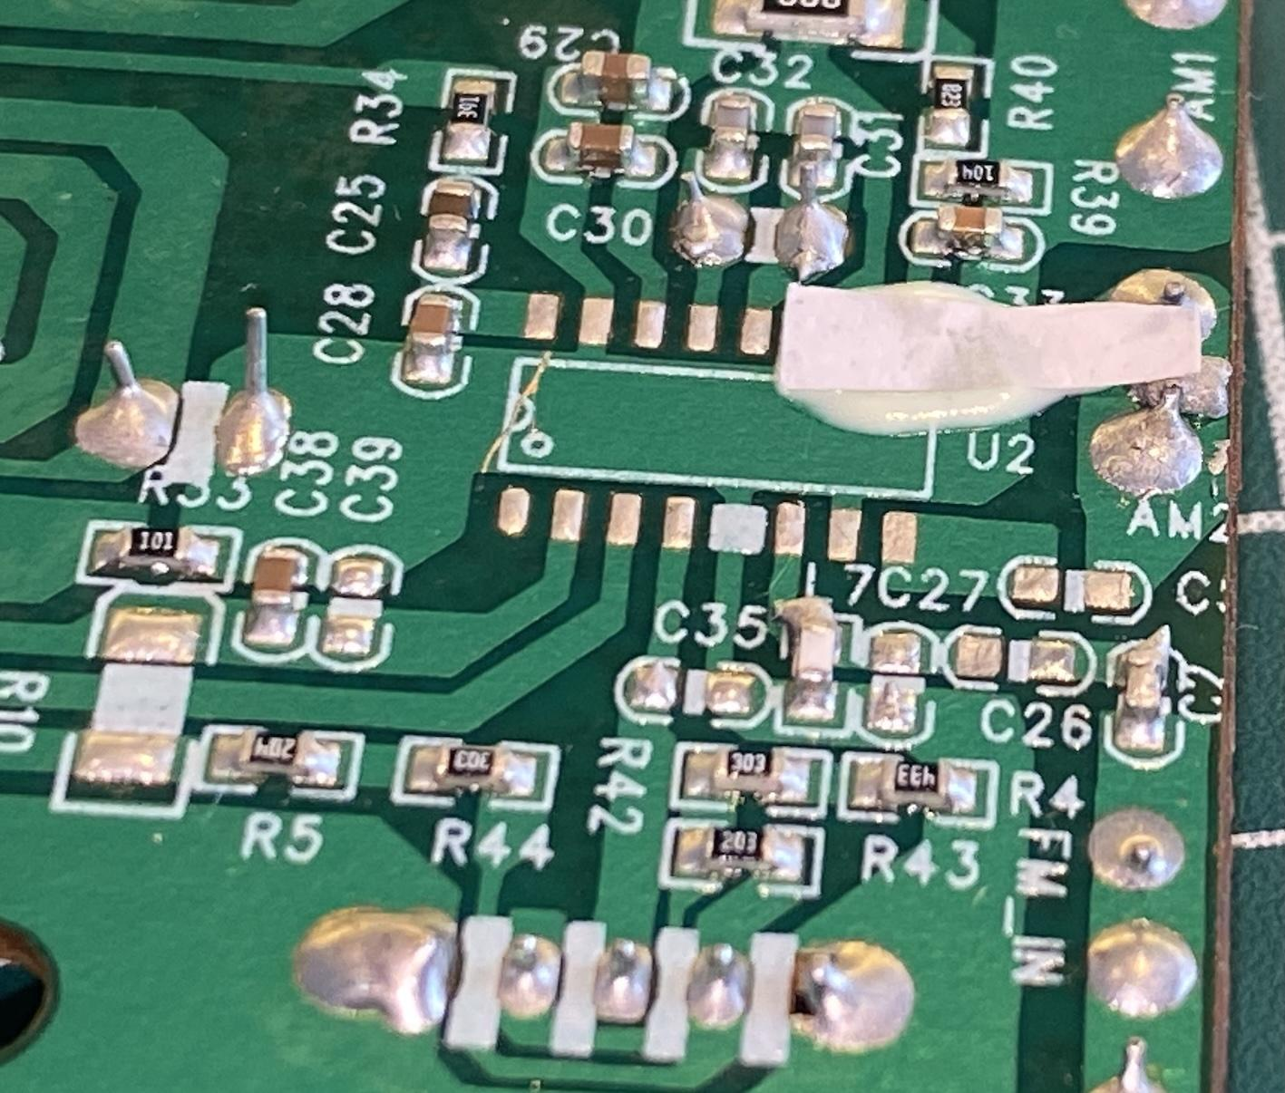
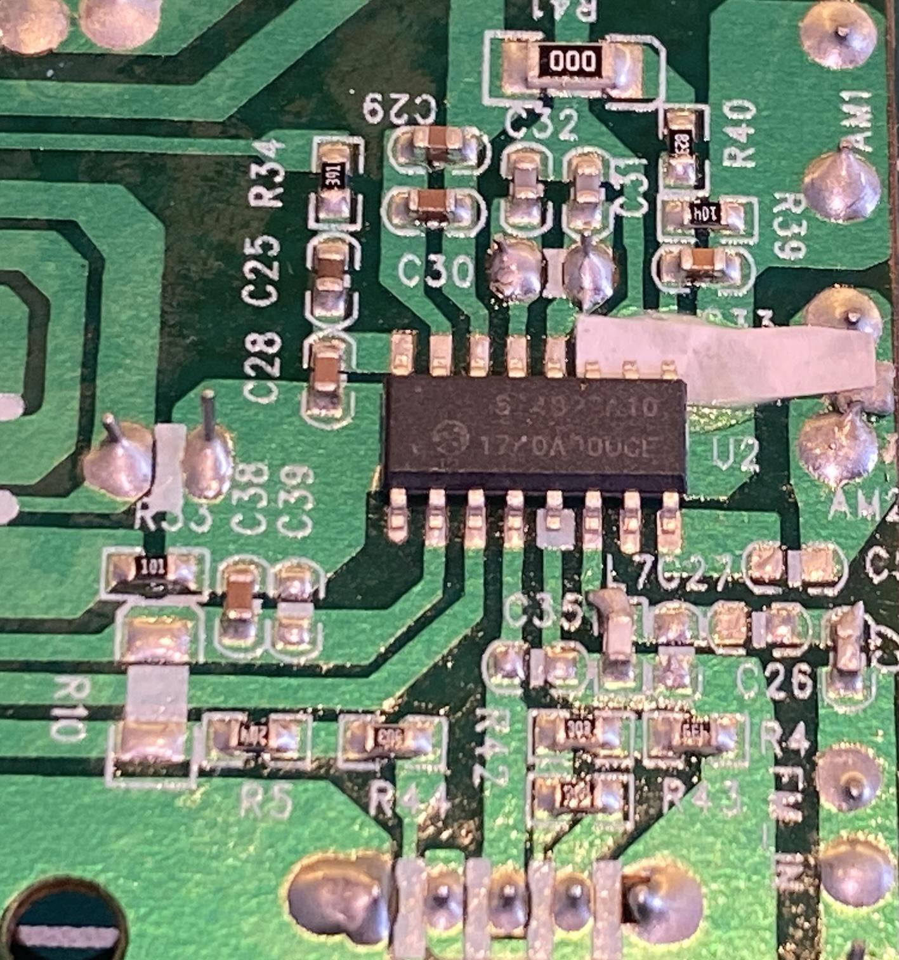
Replacement of Si4825 with Si4827

Slide 11
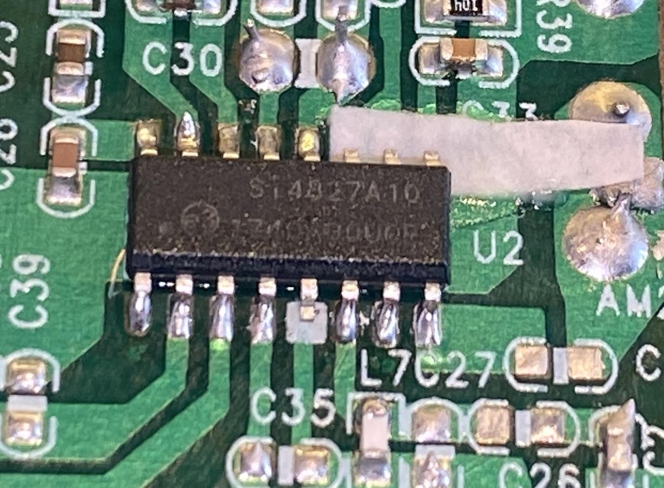
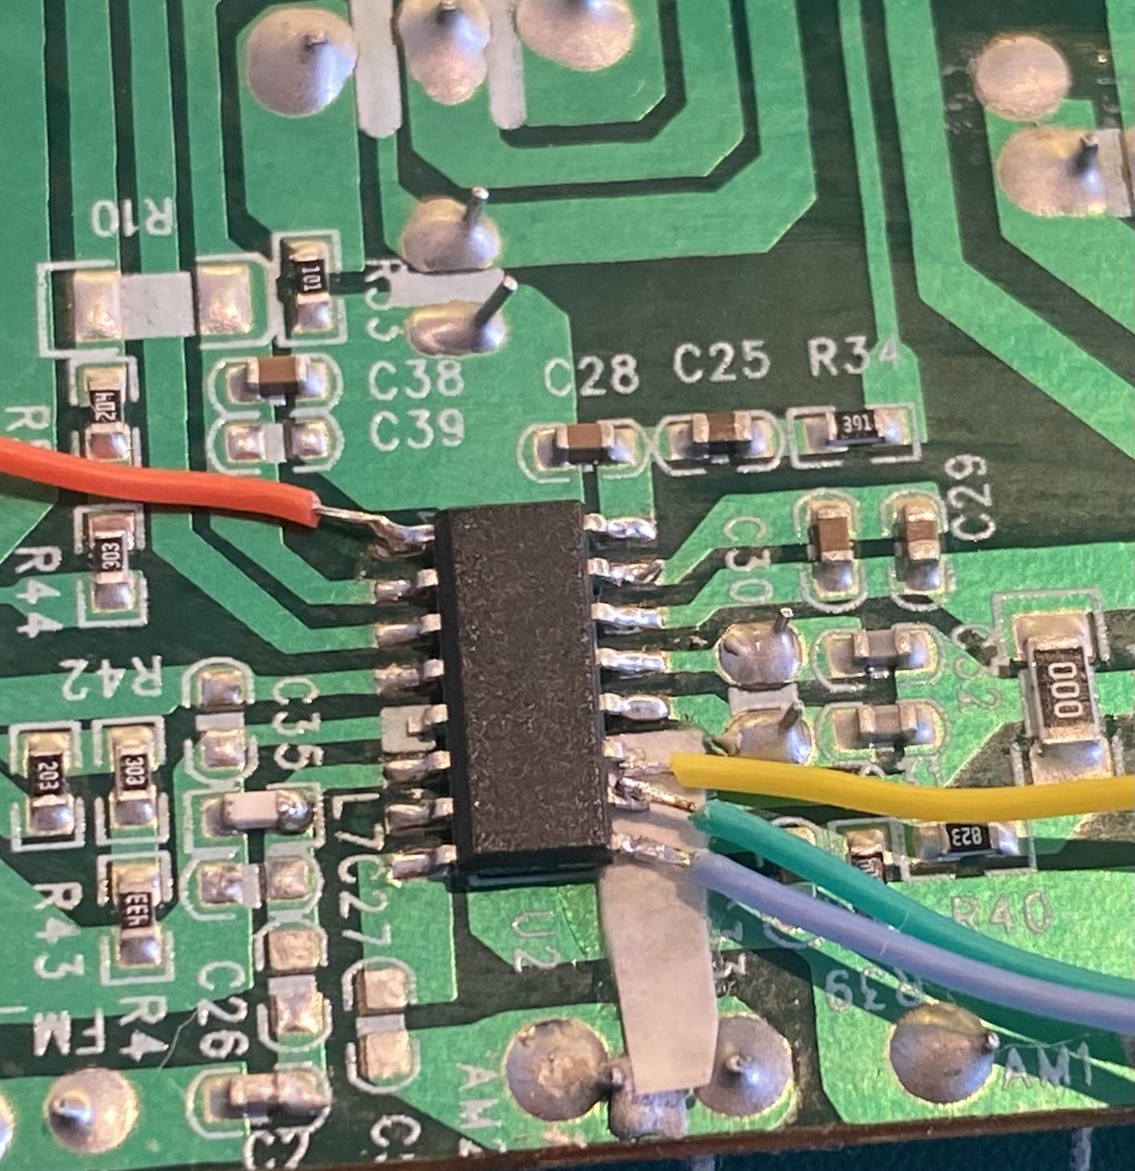
Si4827 soldered on the board

Slide 12
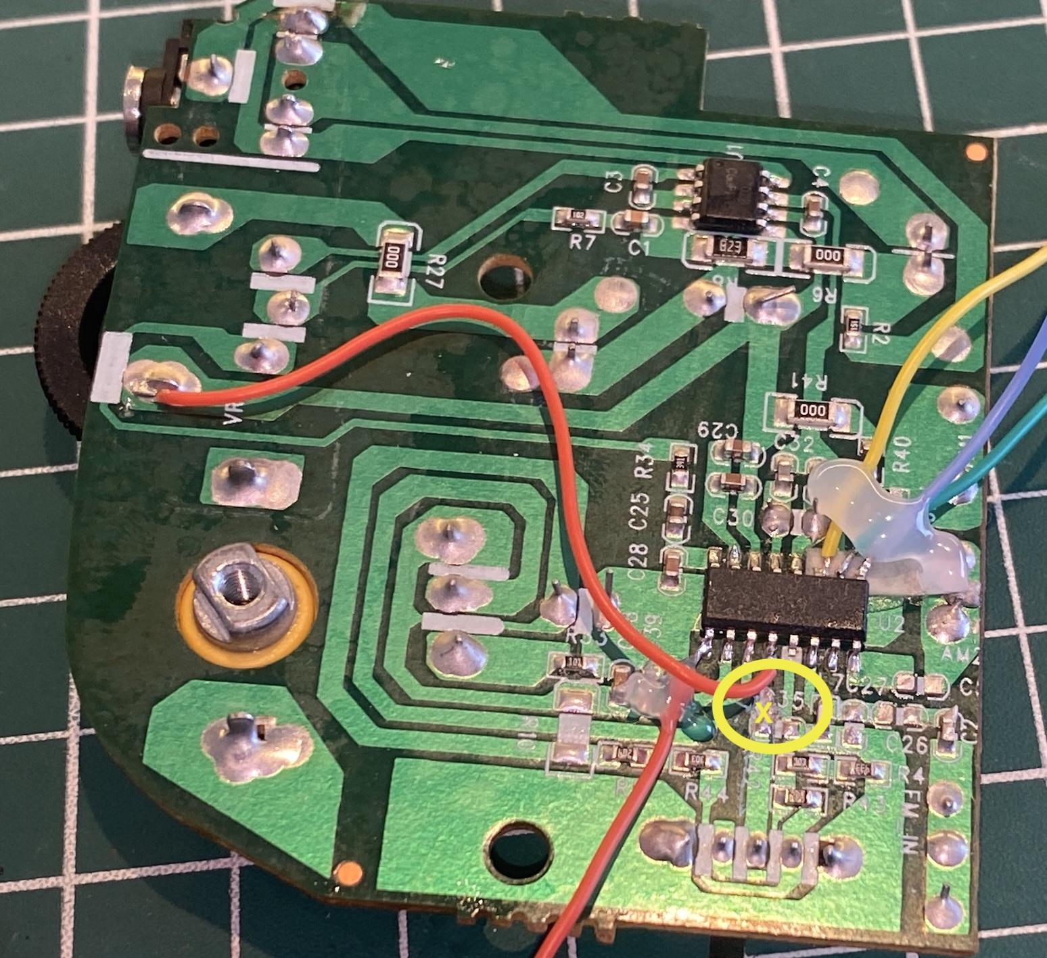
Si4827 with a cut on the trace leading to pin 4 (BAND)

Slide 13
Conexões do Si4827 com o Seeduino XIAO
| SI4827 pin | SEEEDUINO pin | Description |
| --------- | ------------ | ----------------------------|
| 1 | 2 | SEEEDUINO interrupt pin |
| 9 | 6 | RESET |
| 10 | A4 (SDA) | I2C bus (Data) |
| 11 | A5 (SCL) | I2C bus (Clock) |
| -----------| ------------- | ----------------------------|
| OLED | | |
| -----------| ------------- | ----------------------------|
| SDA | 4 | I2C Bus (Data) |
| CLK | 5 | I2C bus (CLock) |
| -----------| ------------- | ----------------------------|
|Push Buttons| | |
| -----------| ------------- | ----------------------------|
| BAND UP | 7 | Próxima Banda |
| BAND DOWN | 8 | Banda Anterior |

Slide 14
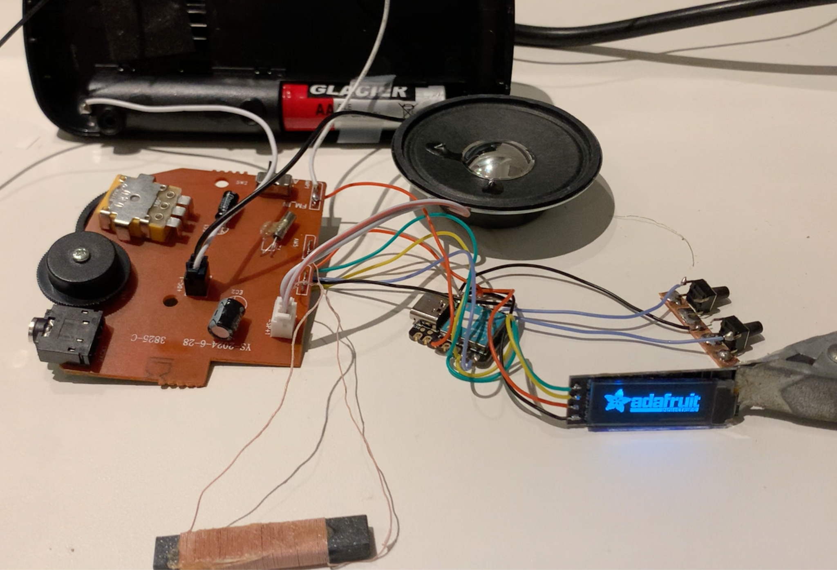
Testando o Si4827 na placa com o Seeduino XIAO

Slide 15
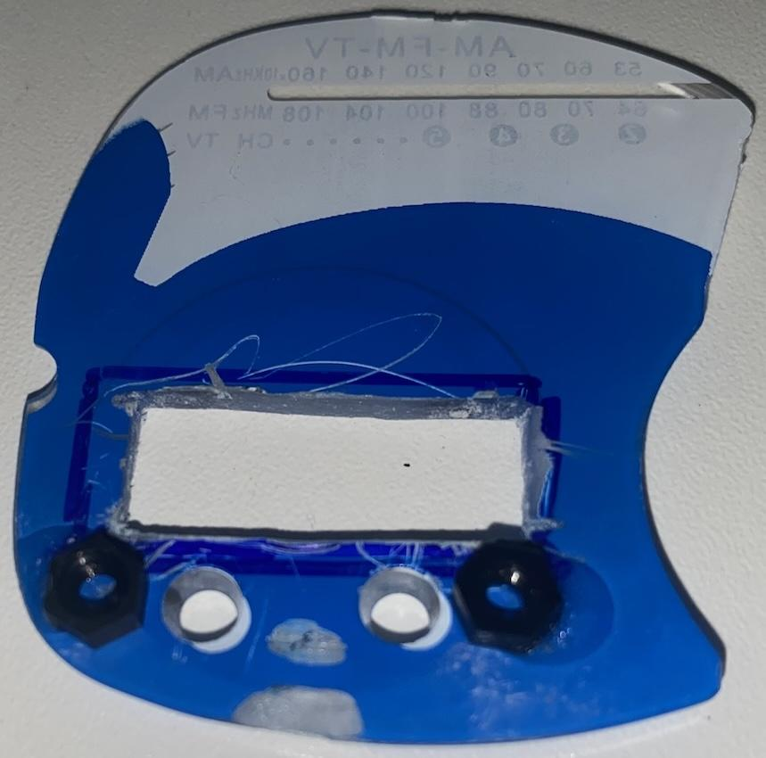
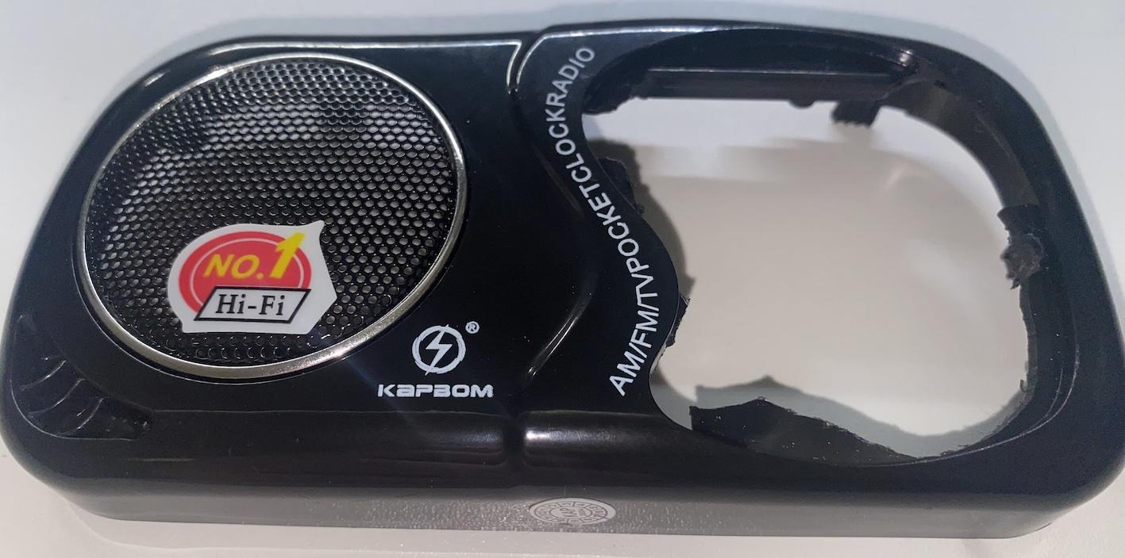
Alteração da Caixa do Rádio

Slide 16
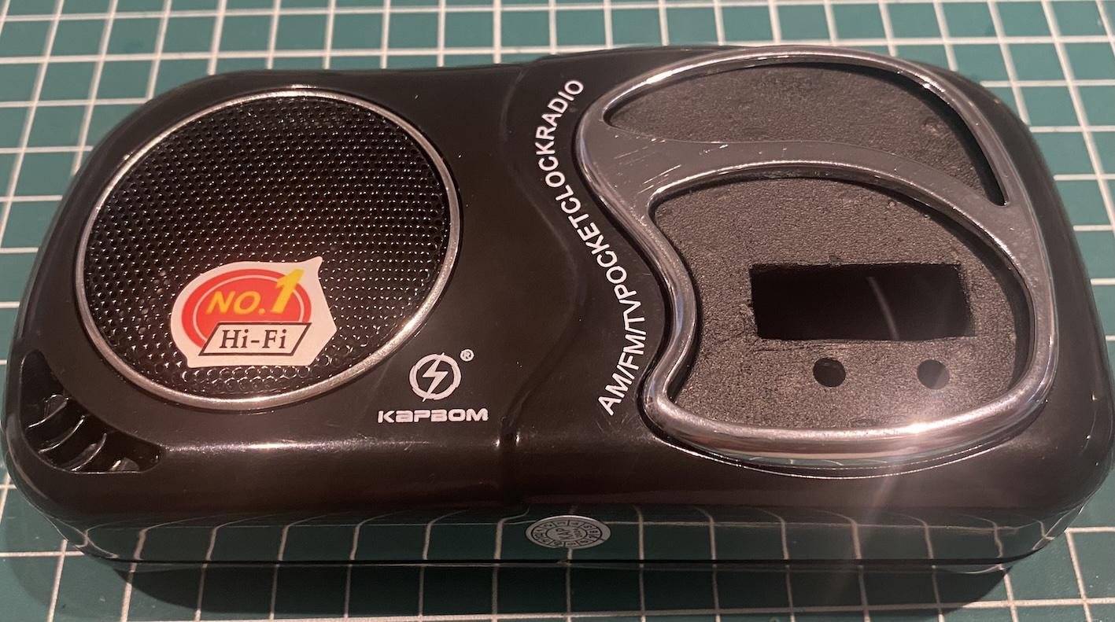
Alteração da Caixa do Rádio

Slide 17
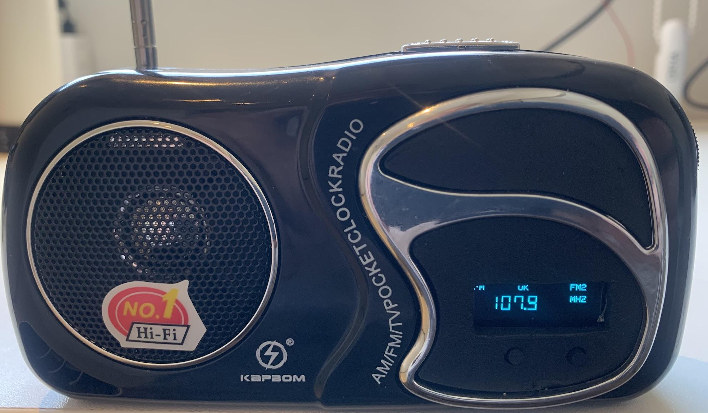
Modificação concluída

